Slide 1
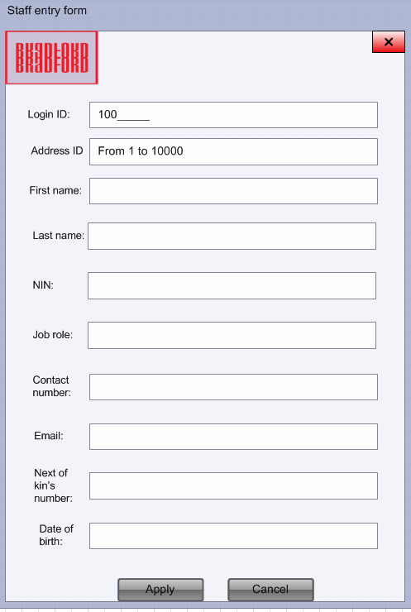
Logo
Exit button
User will have to input numbers in this field. If it doesn’t match our previous records, It will be valid. This have always start with “100”.
User will have to input his first name in this field.
User will have to input his last name in this field.
User will have to input a number between 1 – 10000. If numbers match our previous records a message will pop up informing a user about it.
National insurance number is needed in order to get more information about the staff member.
Identifies role of a staff member.
We demand this so we can contact person that applied for the job.
Another way of contacting our staff member.
Emergency number (optional)
Identifies date of birth of potential staff member.

Slide 2
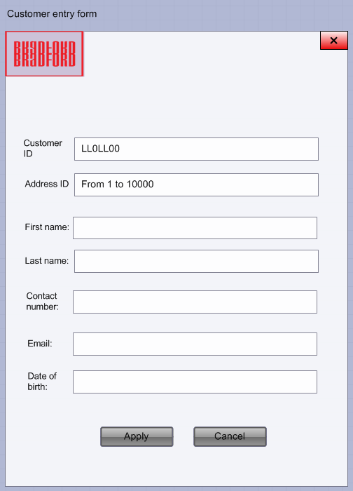
Logo
Exit button
User will have to input (as follows): 2 letters, 1 number, 2 letters and 2 numbers in this field. If it doesn’t match our previous records, It will be valid. This will be always unique to each user.
User will have to input his first name.
User will have to input his last name.
User will have to input a number between 1 – 10000. If numbers match our previous records a message will pop up informing a user about the error.
We demand this so we can contact person if a booking was made for them.
Another way of contacting our customer.
We will be able to see if customer is able to purchase a property

Slide 3
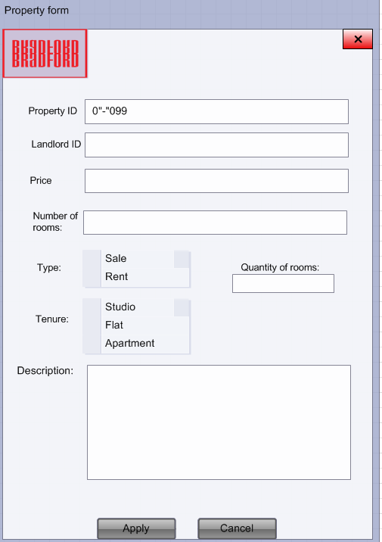
Logo
Exit button
Property ID will be different for each property so there is not duplicates.
This allows Landlord to insert his price
User will have to input his last name.
Drop down box will help justifying the type of the property.
Landlord will have to type his ID in order to insert data and post his property.
Drop down box will help justifying the tenure of the property.
Landlord will be able to specify rooms of the property.
This is a description of a property provided by the landlord.

Slide 4
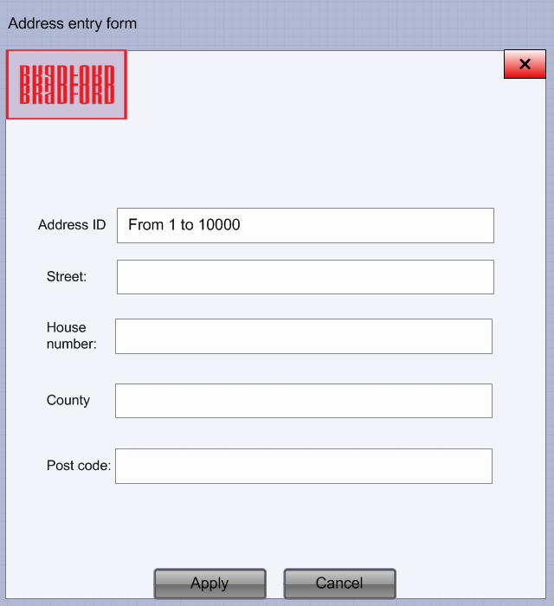
Logo
Exit button
User will have to input a number between 1 – 10000. If numbers match our previous records a message will pop up informing a user about the error.
Staff member or customer will have to provide us with their address which means we will need: Street, house number, county and post code.

Slide 5
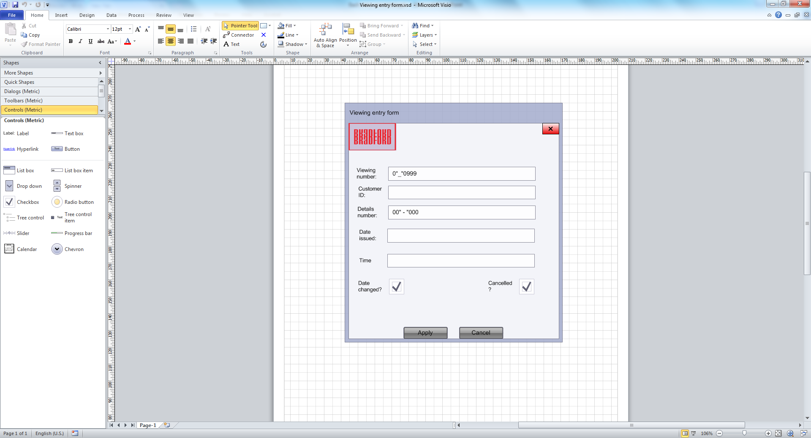
Logo
Exit button
Viewing number will be unique to each viewing so there won’t be any mistakes when it comes to the viewing (there can’t be a human error as database will display that the number is duplicated)
Date issued will be applied by either staff member or the customer.
Customer will be displayed so specific customer will be able to see if the viewing is for him.
This field is for customer and manager to see in-depth information about the viewing.
Time will be issued by either staff member or the customer so they will know when the viewing is.
This is a checkbox that indicates if the date was changed. If the date was changed, the new date will be showed in details table.
This is a checkbox that indicates if the viewing was cancelled. If the viewing was cancelled then the viewing will be dropped, however, the information will stay in the database.

Slide 6
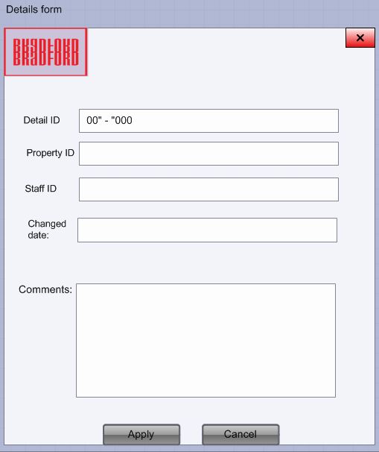
Logo
Exit button
This field is needed for the manager and customer so they will be able to see if it’s the actual property that the viewing is at.
Detail ID will be included to each viewing so the customer or manager will be able to see the details in the table.
This is for the staff that handles the viewing so the manager will be able to see who was responsible for the viewing.
If the date was changed then the staff member will have to put it in here.
Comments about the viewing. If the date changed it needs to be included in here.

Slide 7
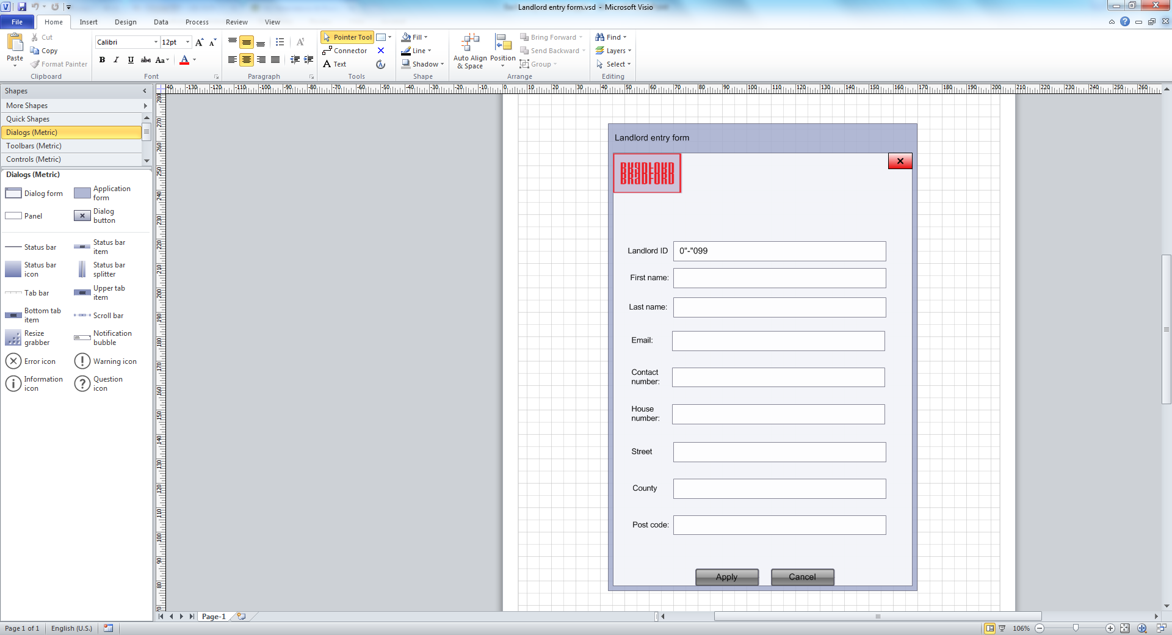
Logo
Exit button
User will have to input his first name in this field.
User will have to input his last name in this field.
Landlord ID is identification for the landlord. It is a field where each record is unique so there won’t be same codes.
We will contact the Landlord if there was viewing issued for his property.
Another way of contacting the landlord if the viewing was made for his property.
Landlord will have to provide us with their address which means we will need: house number, street, county and post code.

